Slide 1








CAPSTONE PROJECT
Modupeola Olufunke Alade
21st April 2022

Slide 2



OUTLINE
Executive Summary
Introduction
Methodology
Results
Programming Language Trends
Database Trends
Dashboard(s)
Discussion
Findings & Implications
Conclusion
Appendix

Slide 3

EXECUTIVE SUMMARY
The use of technology in our everyday lives and harnessing it to our advantages is one vital part we need to pay attention to.
In this report,
current and future databases and programming languages are looked at;
how these changes over time;
its drastic usage increase in future years; and
what that will mean for one who plans on venturing in the study or use of any of them.

Slide 4

INTRODUCTION
This report is about using IBM Cognos in creating dashboards with various visuals presenting data for current and future technology trends (regarding programming languages, databases, platforms and web frames) likewise demographics (based on gender, age, countries and a combination of gender and formal education).
This report is for anyone wanting to venture into learning a database querying and/or programming language skill. By reading through this report, a reader will gain more insights into knowing the current and future programming languages and databases in circulation.

Slide 5

METHODOLOGY
For the dashboard tabs, two files were provided from the web: m5_survey_data_demographics.csv and m5_survey_data_technologies_normalised.csv.
For the GitHub job postings slide, the job postings data was collected using GitHub API into a file named “github-job-postings.xlsx”.
For the Popular languages slide, the data was collected using web scraping into a file named “popular-languages.csv”.
Charts were developed using Python, Excel and IBM Cognos environments.

Slide 6
RESULTS
Programming language trends
This shows two bar charts with details for the top 5 current year and next year programming trends.
Programming language trends – Findings and Implications
Database trends
This shows two bar charts with details for the top 5 current year and next year database trends.
Database trends – Findings and Implications

Slide 7
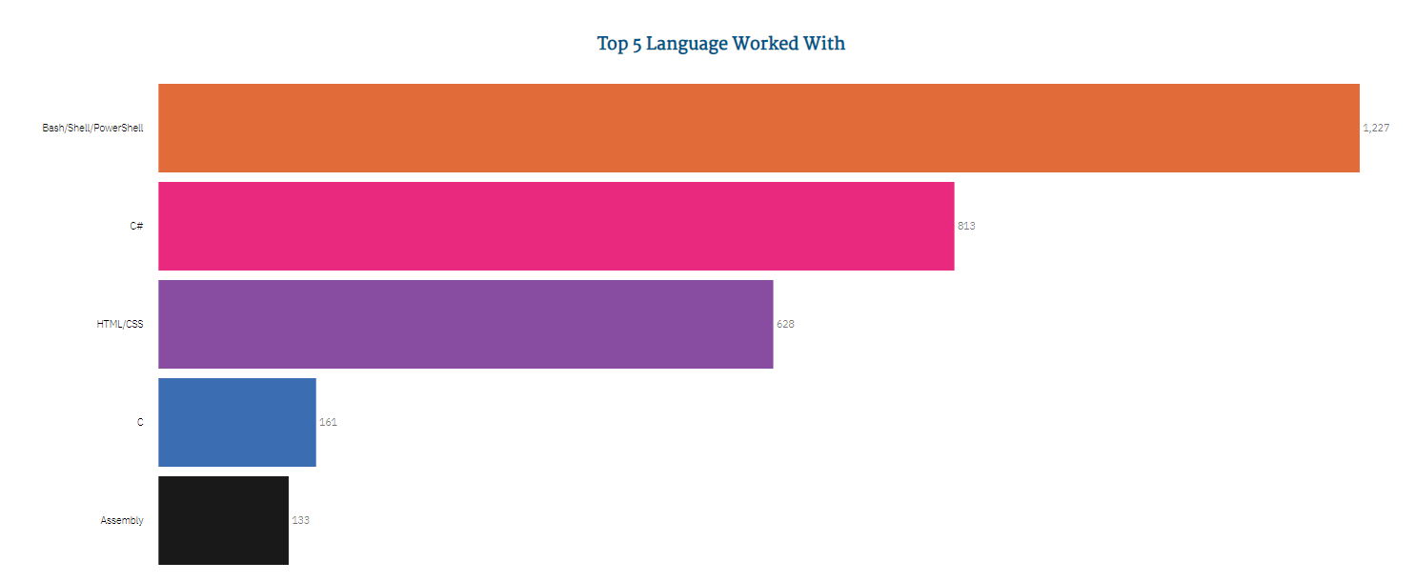
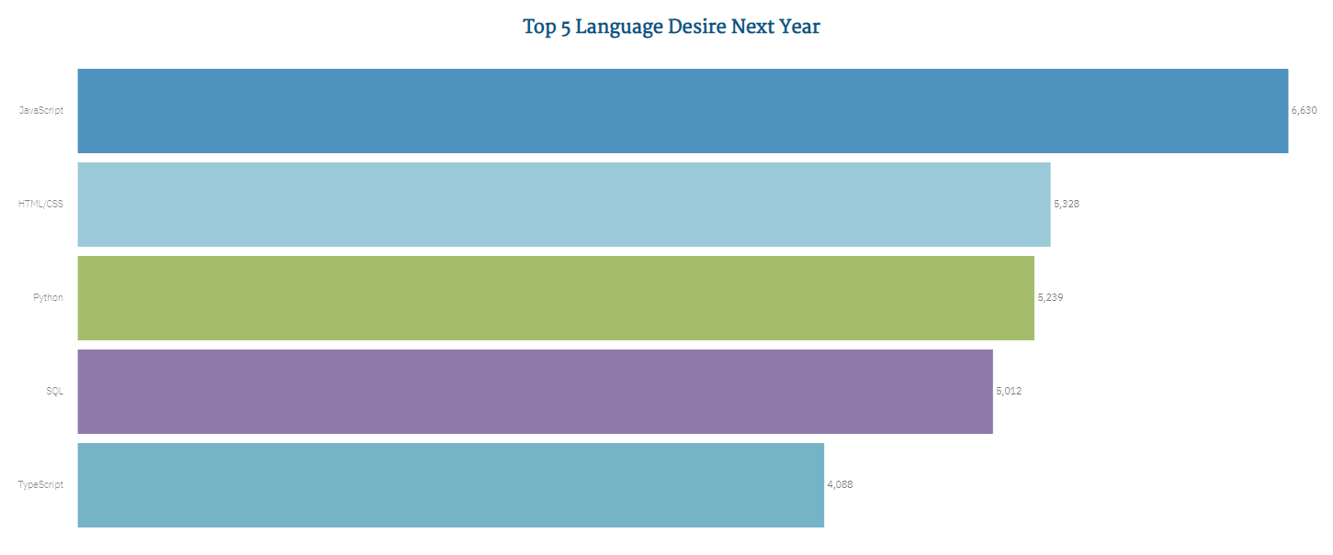
PROGRAMMING LANGUAGE TRENDS
Current Year
Next Year

Slide 8
PROGRAMMING LANGUAGE TRENDS - FINDINGS & IMPLICATIONS
Findings
The top 5 current programming languages are Bash/Shell/PowerShell, C#, HTML, C and Assembly while the top 5 future programming languages are JavaScript, HTML/CSS, Python, SQL and TypeScript.
Bash/Shell/PowerShell is the top current programming language with 1227 enrollments while JavaScript is the top future programming language with 6630 enrollments.
HTML/CSS seems to be a very relevant programming language currently and, in the future, as it can be seen to be still be in the top 5 in both trends.
Python ranked third in the top 5 future programming language.
Implications
The current trending programming languages might not be the top ones in the future such as Bash/Shell/PowerShell, C#, C and Assembly.
The trend of programming languages in use varies and changes with respect to time.
The knowledge of HTML is a plus at both times.
Python will be a good programming language to learn now because it comes as a good choice in the coming year.

Slide 9
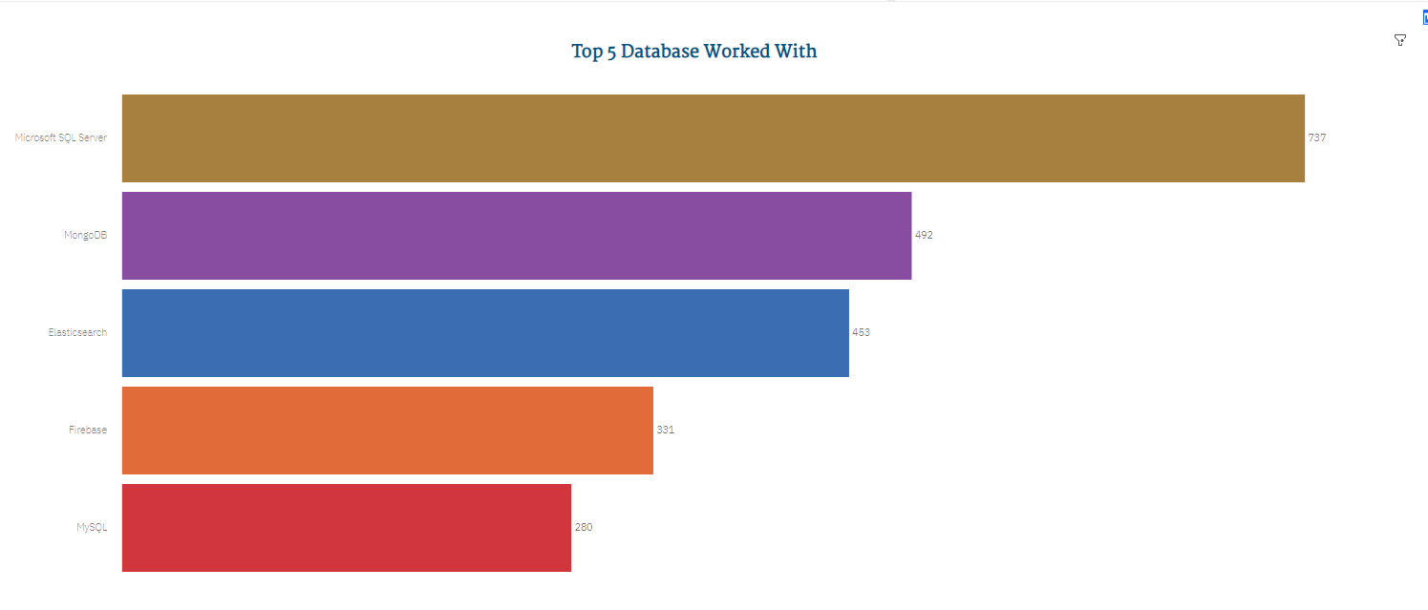
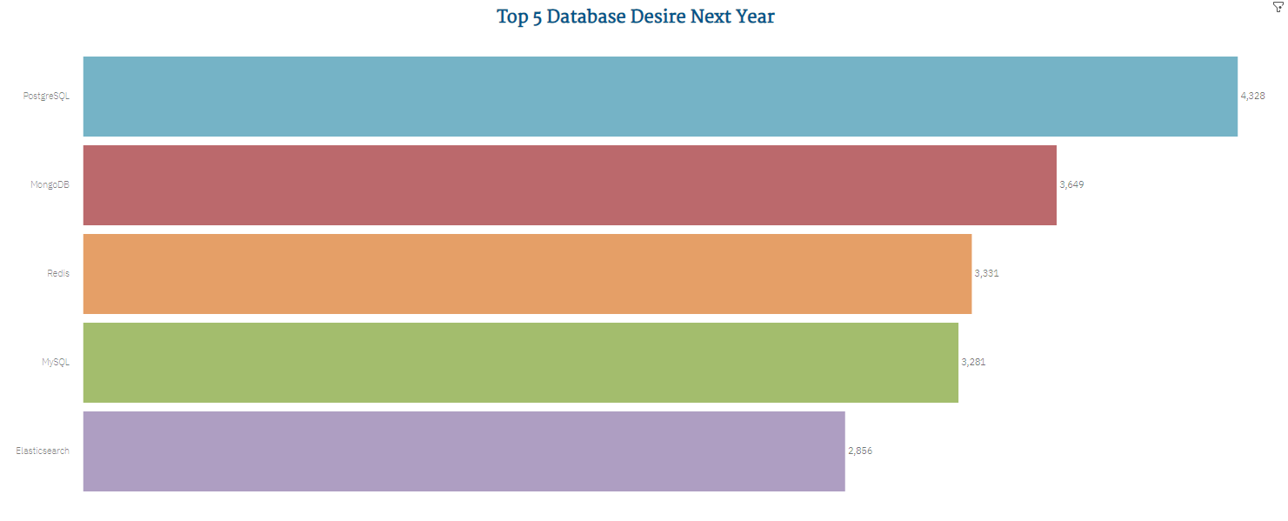
DATABASE TRENDS
Current Year
Next Year

Slide 10
DATABASE TRENDS – FINDINGS & IMPLICATIONS
Findings
The top 5 current database are SQL Server, Mongo DB, ElasticSearch, Firebase and MySQL while the top 5 future databases are PostgreSQL, MongoDB, Redis, MySQL and ElasticSearch.
SQL Server is the top current database in use with 737 enrollments while PostgreSQL is the top future programming language with 4328 enrollments.
MongoDB can be seen to maintain its position as the top 2nd database both currently and in the future trends.
MySQL and ElasticSearch also remained on the top 5 spots in both trends.
The study and use of databases grew greatly, like 6 times in figures more in the upcoming year than currently.
Implications
The current trending databases might not be the top ones in the coming year such as SQL Server been replaced at the top by PostgreSQL in the coming year.
The learning MongoDB will be beneficial both now and in the coming year
MySQL and ElasticSearch are also important tools that will be beneficial now and in the coming year.
Getting into the knowledge of database now is good because the use will be greatly increased in the coming year.

Slide 11

DASHBOARD
The permanent link for the IBM Cognos dashboard:
https://ibm.co/3vyuii8

Slide 12
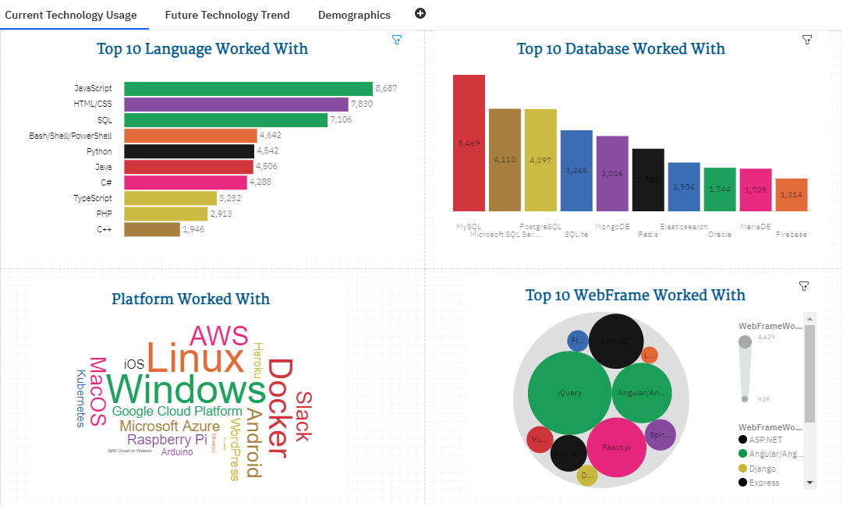
DASHBOARD TAB 1

Slide 13
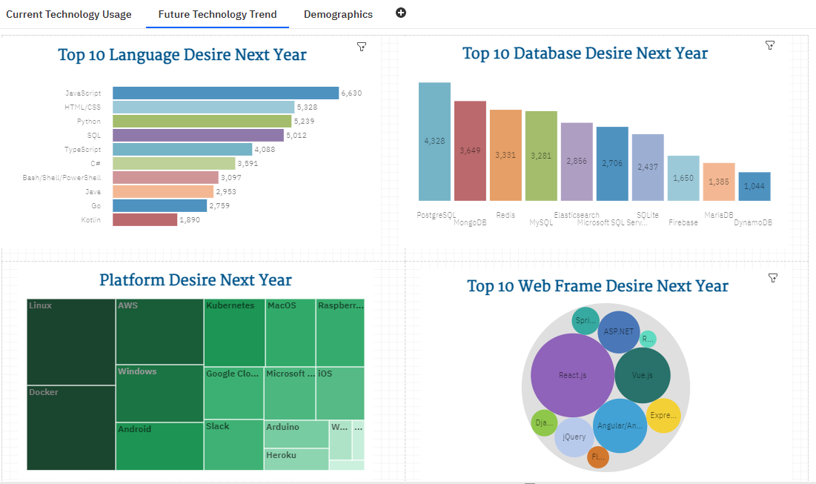
DASHBOARD TAB 2

Slide 14
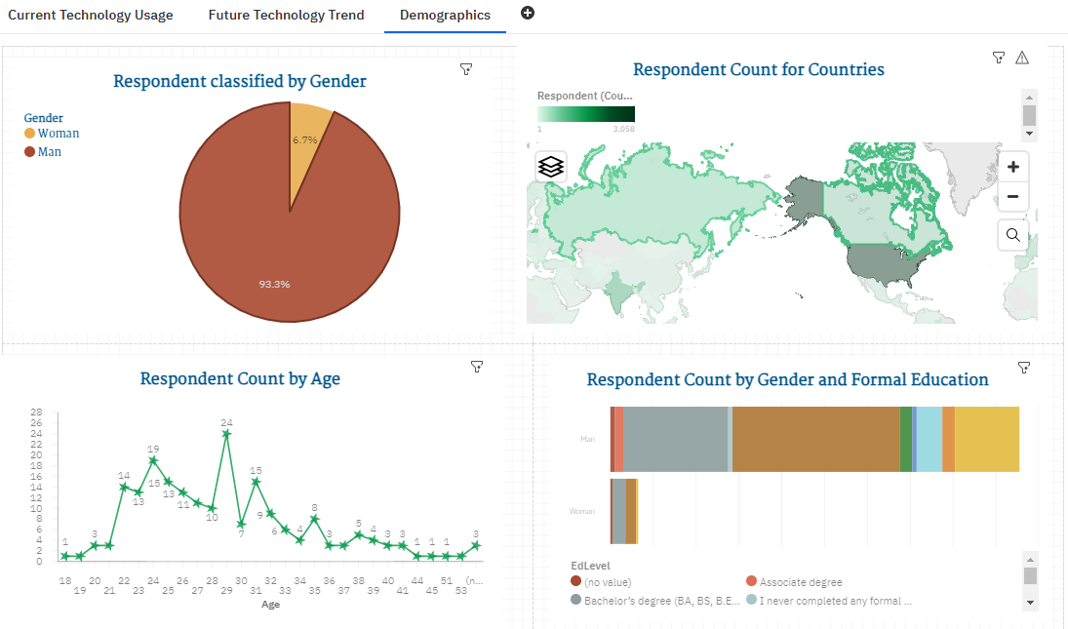
DASHBOARD TAB 3

Slide 15

DISCUSSION
Overall Findings
Overall Implications

Slide 16
OVERALL FINDINGS & IMPLICATIONS
Findings
JavaScript and HTML/CSS remained as the top two programming languages both in current and future technology trends.
Six other programming languages also remained within the top 10 spots in both current and future trends. As for the databases, nine out of the top 10 in the current trend still proved relevant with the top 10 in the future trends.
There are more male respondents than female respondents which shows the field is largely male-dominated.
Those in countries such as USA, Canada, UK, Germany are a lot grounded in these technology compared to bare lowest we have in the African continent.
Respondents with a bachelors degree, masters degree and some college study are the majority the uses of these technologies.
Respondents between the ages of 22 – 24, 29 and 31 are those who use these technologies more.
Implications
The knowledge and use of JavaScript and HTML/CSS remains relevant those the years.
Learning or using any other constant top programming language and/or databases will be at a advantage.
The technology field will continually be male dominated unless more females dive into this field.
As the developing countries are embracing technology and its trend to the better their nations, Africa needs to do likewise to as not to be left behind.
Quite the learned ones are the one who make use of these technologies, so it can be inferred that these skills are taught in colleges/universities.
Learning these skills at the ages mentioned is good but would be better in formative ages.

Slide 17

CONCLUSION
A few insights that could be derived from this report are:
Technology trend changes over time likewise we have to move with the trend.
The knowledgeable use of JavaScript, HTML/CSS and one database technology (say PostgreSQL) would be a good combination for any aspiring technology personnel.
New emerging database and programming languages use will surely always emerge but once the fundamentally basic ones are known, one has an edge ahead.
Technology trends should not be limited to just colleges/universities but should be incorporated from basic school levels.

Slide 18

APPENDIX
GitHub Job Postings
Popular Languages

Slide 19
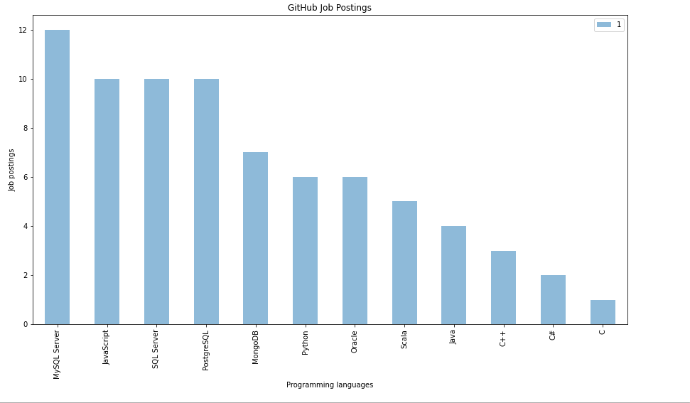
GITHUB JOB POSTINGS

Slide 20
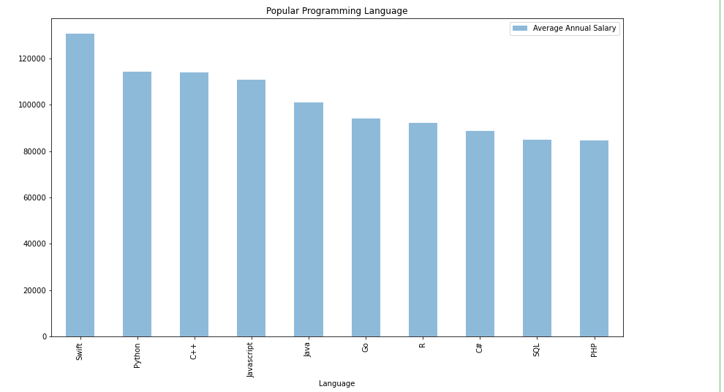
POPULAR LANGUAGES

